Slide 1
Introduction to
NeMo & Jarvis

Slide 2
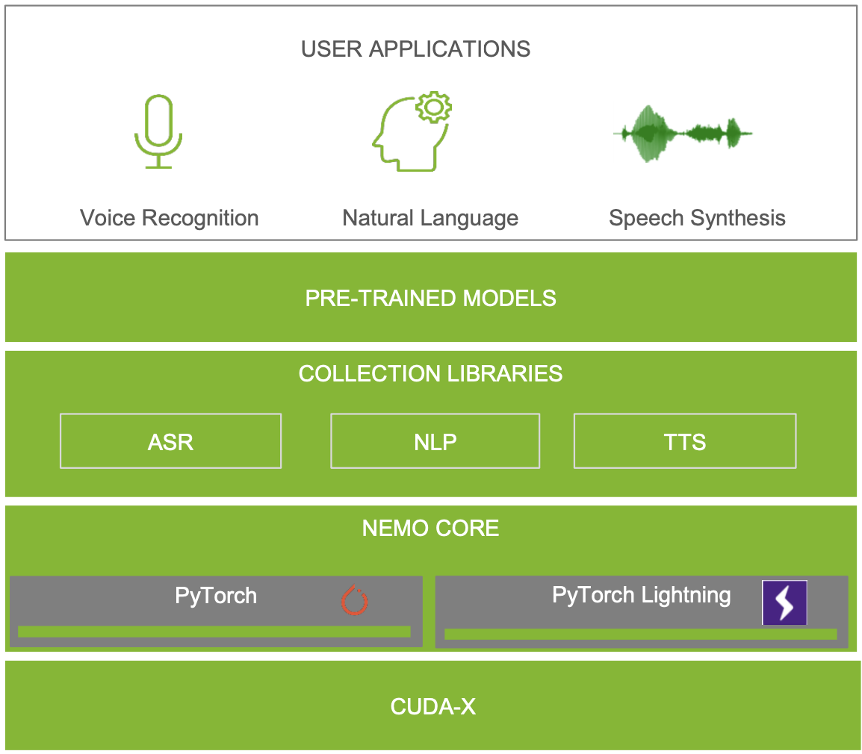
NeMo : A Toolkit for Conversational AI
Collection of SOTA in ASR, TTS and NLP.
Pretrained available on Nvidia Cloud ( NGC ).
High performance training on Nvidia GPUs.
Flexible configure and customize models.

Slide 3
Model Implementation in NeMo
Speech processing
Automatic Speech recognition (ASR): Jasper, QuartzNet, CitriNet, Conformer
Speaker Recognition: SpeakerNet
Speaker Diarization: MarbleNet + SpeakerNet
Natural Language Processing
Token classification (named entity recognition)
Text classification
BERT pre-training
Neural Machine Translation (NMT)
Speech synthesis (TTS)
Spectrogram generation: Tacotron2, GlowTTS, FastSpeech2, FastPitch
Vocoders: WaveGlow, SqueezeWave, UniGlow, MelGAN, HiFiGAN
see more at NVIDIA/NeMo: NeMo: a toolkit for conversational AI (github.com)

Slide 4
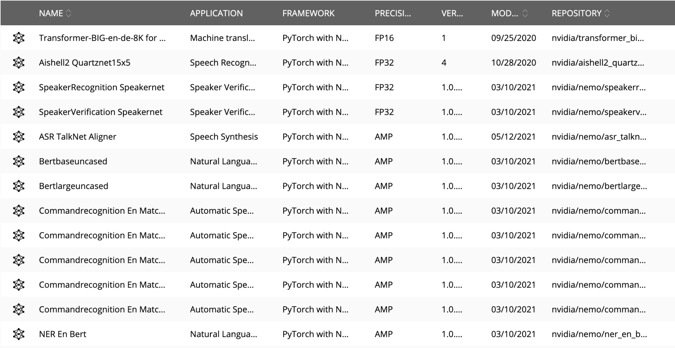
Pretrained on Nvidia NGC
see more at : https://ngc.nvidia.com

Slide 5
High Performance Training
Tight integration with PyTorch Lightning Trainer to easily invoke training actions.
trainer:
gpus: 1 # number of gpus
precision: 16 # mixed precision
num_nodes: 1 # number of nodes
Mixed precision training
Multiple Nodes and Multiple GPUs training
Example config for Pytorch Lightning Trainer.
trainer = pl.Trainer(**cfg.trainer) asr_model = EncDecCTCModel(cfg=cfg.model, trainer=trainer)
trainer.fit(asr_model)
Training with Pytorch Lightning Trainer API.

Slide 6
Customize & Configure model in NEMO
name: &name "QuartzNet15x5"
model:
sample_rate: &sample_rate 16000
repeat: &repeat 5
dropout: &dropout 0.0
separable: &separable true
labels: &labels [" ", "a", "b", "c", "d", "e", "f", "g", "h", "i", "j", "k”, "l", "m", "n", "o", "p", "q", "r", "s", "t", "u", "v", "w", "x", "y", "z", ”’”]
train_ds:
manifest_filepath: ???
sample_rate: 16000
labels: *labels
…
…
Flexible customize and configure model in NeMo
Configurable with both YAML and Hydra CLI commands
QuartzNet Model Customization with .YAML file

Slide 7
Example ASR Fine Tuning
Edit manifest file path in config .YAML file
train_ds:
manifest_filepath: ???
sample_rate: 16000
labels: *labels
validation_ds:
manifest_filepath: ???
sample_rate: 16000
labels: *labels
test_ds:
manifest_filepath: null
sample_rate: 16000
labels: *labels
optim:
name: novograd
lr: .01
# optimizer arguments
betas: [0.8, 0.5]
weight_decay: 0.001
# scheduler setup
sched:
name: CosineAnnealing
# Scheduler params
warmup_steps: null
warmup_ratio: null
Adjust learning rate
Example config file :
NeMo/quartznet_15x5.yaml at main · NVIDIA/NeMo (github.com)

Slide 8
Example ASR Fine Tuning (1)
Import libraries
import pytorch_lightning as pl
from omegaconf import OmegaConf, DictConfig
from nemo.collections.asr.models import EncDecCTCModel
Use pretrained provide by Nvidia
Can see list of pretrained model by using EncDecCTCModel.list_available_models()
asr_model = EncDecCTCModel.from_pretrained(model_name="QuartzNet15x5Base-En")
Load from your own checkpoint
asr_model = EncDecCTCModel.load_from_checkpoint("xxx.ckpt")

Slide 9
Example ASR Fine Tuning (2)
cfg = OmegaConf.load('quartznet_15x5.yaml')
trainer = pl.Trainer(**cfg.trainer)
exp_manager(trainer, cfg.get("exp_manager", None))
Load config file and set trainer
Setup optimization and data loader
asr_model.setup_optimization(optim_config=cfg.model.optim)
asr_model.setup_training_data(train_data_config=cfg.model.train_ds)
asr_model.setup_validation_data(val_data_config=cfg.model.validation_ds)
asr_model.setup_test_data(val_data_config=cfg.model.test_ds)
asr_model.set_trainer(trainer)
Train model
trainer.fit(asr_model)

Slide 10
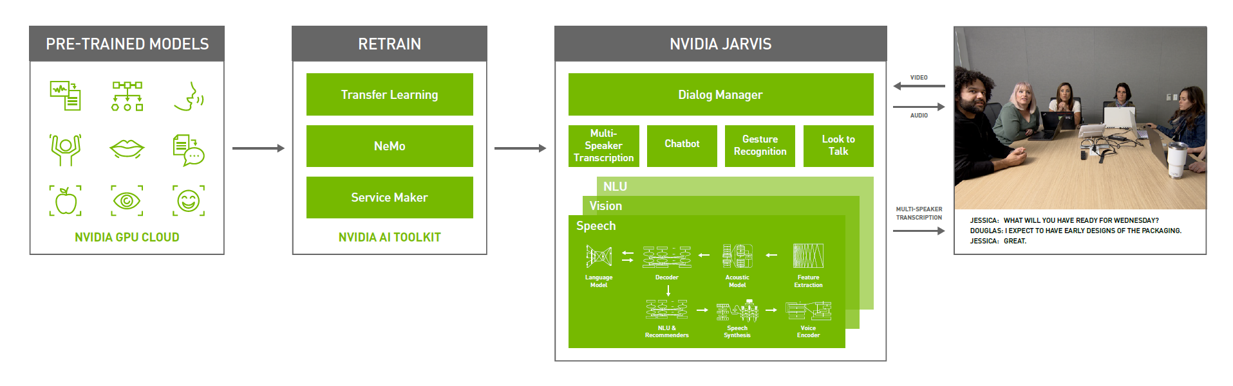
Jarvis : Multimodal Conversational AI Services

Slide 11

Example of Application

Slide 12
Jarvis Service
Speech Recognition
Supporting sample rates: 8, 16, 32, 44, 48 kHz
Acoustic Model: Jasper, Quartznet
Fully optimized End-to-End Pipeline
NLU
High-Levels API
Enitity Recognition
Intent Classification
Question Answering
Punctuation and Capitalization
Low-Levels API
Classify Text (sentiment classification, domain recognition, etc)
Classify Token
Transform Text (translation, adding punctuation, augment the input)
Speech Synthesis
Supporting sample rates: 22 kHz
Model: Tacotron2+Waveglow
Fully optimized End-to-End Pipeline
Notes:
High-Levels API -> implement task-specific APIs for popular NLP tasks including intent recognition (as well as slot filling), and entity extraction.
Low-Levels API -> provides generic NLP services for custom model use cases. The intent of this service is to allow users to design models for arbitrary use cases that conform simply with input and output types specified in the service.

Slide 13
Performance of ASR
*Benchmark on NVIDIA A100

Slide 14
Performance of TTS
*Benchmark on NVIDIA A100

Slide 15
Example call Jarvis ASR API
import io
import jarvis_api.jarvis_asr_pb2 as jasr
import jarvis_api.jarvis_asr_pb2_grpc as jasr_srv
channel = grpc.insecure_channel('localhost:50051')
jarvis_asr = jasr_srv.JarvisASRStub(channel)
with io.open(“wavfile.wav”, 'rb') as fh: # read audio
content = fh.read()
req = jasr.RecognizeRequest()
req.audio = content # raw bytes
req.config.encoding = ja.AudioEncoding.LINEAR_PCM # Supports LINEAR_PCM, FLAC, MULAW and ALAW audio encodings
req.config.sample_rate_hertz = 22050 # Audio will be resampled if necessary
req.config.language_code = "th-TH"
req.config.max_alternatives = 1 # How many top-N hypotheses to return
req.config.enable_automatic_punctuation = False # Add punctuation when end of VAD detected
req.config.audio_channel_count = 1 # Mono channel
response = jarvis_asr.Recognize(req)
asr_best_transcript = response.results[0].alternatives[0].transcript

Slide 16
Demo using NeMo & Jarvis

